Slide 1

Spring Cleaning
2022 WPPA Safety Clinic
23 Apr 2022
www.paramerica.us
Jon Eisele
FAA CFI/USPPA Paramotor Instructor
ParAmerica LLC
© ParAmerica LLC, 2022

Slide 2
Agenda
www.paramerica.us
  Risk Management
  Human Factors
  Anatomy of a Mistake
The “Traps”
Margins and Minimums
Action Plan
© ParAmerica LLC, 2022

Slide 3
Survey
www.paramerica.us
How many paramotor, paragliding, PPC pilots? Students?
How many pilots here fly at least once a month between May and October?
How many pilots here fly at least once a month between October and May?
© ParAmerica LLC, 2022

Slide 4
Out of Hibernation
www.paramerica.us
Our “para community” typically sees an uptick every spring in accidents that could be attributed to mental error, rust, skill decay, or accidental negligence
Easier to take risk when you’re wearing shorts than when you’re layered up
View this class as an annual vaccine
© ParAmerica LLC, 2022

Slide 5
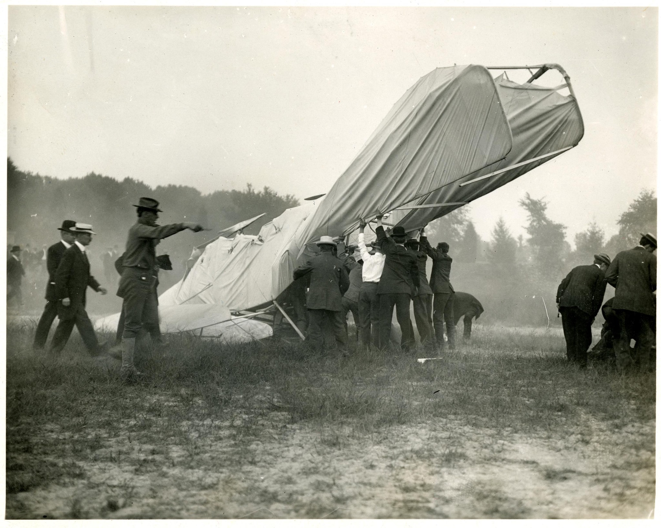
"In flying I have learned that carelessness and overconfidence are usually far more dangerous than deliberately accepted risks."
-Wilbur Wright, September 1900
© ParAmerica LLC, 2021
© ParAmerica LLC, 2022

Slide 6
Risk Management
www.paramerica.us
There’s risk inherent to everything that we do in life, and flying is no exception
Risk awareness and mitigation are critical ingredients to safe flying
The sport of paramotoring is not completely safe, but largely as safe as the decisions we make and the level of risk we accept
© ParAmerica LLC, 2022

Slide 7
Human Factors
www.paramerica.us
In your own words, how would you describe the subject of human factors?
© ParAmerica LLC, 2022

Slide 8
www.paramerica.us
PEOPLE ARE DUMB.
(including you)
(including me)
(nobody is the exception to the rule)

Slide 9
Human Factors
www.paramerica.us
We lack unlimited concentration, focus, and memory
Influenced by factors including ego, attitudes, emotions, stress, and distractions
They will always be prone to committing errors
Properly designed systems expect human error
© ParAmerica LLC, 2022

Slide 10
Anatomy of a Mistake
www.paramerica.us
Accidents are often the result of multiple contributing factors
Our own decision-making often plays a significant role in the outcome of the situation.
Contributing factors can occur in a wide range of domains from Latent Errors to Active Errors
Identify & stop unsafe acts or conditions before they result in consequences!
© ParAmerica LLC, 2022

Slide 11
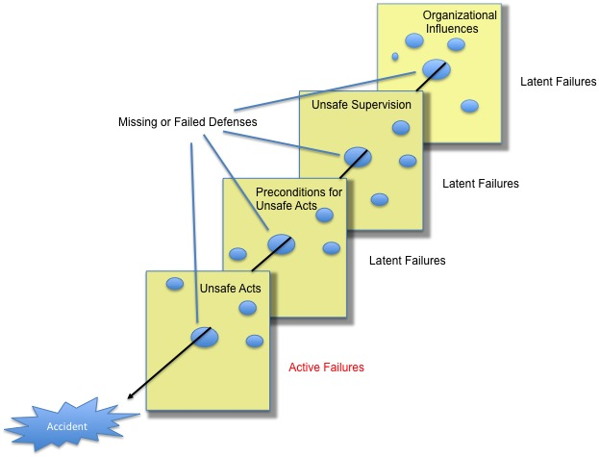
www.paramerica.us
© ParAmerica LLC, 2022

Slide 12
www.paramerica.us
Culture
Fatigue/Stress
Haste
Incomplete Checklist
© ParAmerica LLC, 2022

Slide 13
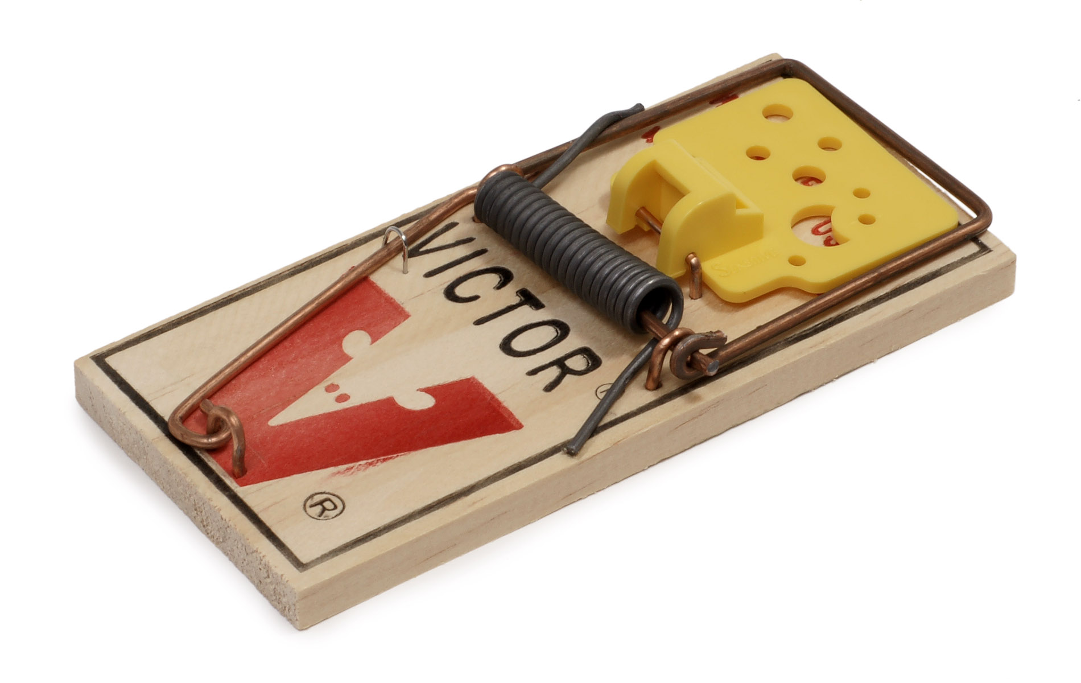
The “Traps”
www.paramerica.us
© ParAmerica LLC, 2022

Slide 14
Hazardous Attitudes
www.paramerica.us
ATTITIUDE | DESCRIPTION | ANTIDOTE
Defiance | “I know better…” | Obedience
Impulsivity | “I’m just gonna send it!” | Thoughtfulness
Invulnerability | ”That would never happen to me..." | Vulnerability
Overconfidence | “I need to show everyone..." | Humility
Resignation | Denial, disbelief, abandonment, hopelessness, reliance on luck | Commitment
Complacency | Comfort-based decisions | Discipline
© ParAmerica LLC, 2022
Notes:
A defiant attitude leads us to believe that the rules don’t apply to us, resent constructive criticism from others, or simply believe that we know better than others. We must be willing to accept criticism as much as we’re willing to dish it out and obey the rules.
Impulsivity describes behaviors characterized by inadequate forethought or consideration of possible consequences, spontaneous actions based on emotions instead of calculated risk. The most dangerous flight we can expect to encounter is the unscripted joyride. We must always think before we act, and consider all possible outcomes of our actions, both good and bad.
Invulnerability is a self-maintained delusion that we are not capable of making mistakes or susceptible to the same mistakes made by others. Oftentimes, this leads us to believe that we’re better than we really are.
Overconfident behaviors are based in macho attitudes, excessive pride or disproportionate belief in our abilities, and lead us to accept unnecessary risks due to a perceived gain or the tendency to want to impress others with our skills
An attitude of resignation leads us to hope that things work out, rely on luck, abandon efforts to correct the situation, resign our outcome to fate. Luck is not a strategy, there is no room for hope in aviation. You must remain committed to every situation you encounter and continue to fly the glider until it’s back in the bag.
Complacency is a gradual, insidious process in which the unacceptable becomes acceptable, in the absence of adverse consequences. Complacency happens when things have been going well!
Discipline overcomes complacency
Have a standard and plan for each flight — self debrief, and critique yourself against the standard you set. Every deviation from the standard must be questioned

Slide 15
The “Traps”
www.paramerica.us
Unrealistic expectations/skill decay
Normalization of Deviance/Complacency
Outside Influences (distractions, motivations, showing-off)
Culture/Groupthink/Peer Pressure*
Cognitive Biases (Continuation and Confirmation)
Overconfidence in equipment/invulnerability complex
Low acro/cheap thrills/“full-send” mentality
Flying with pilots that are more experienced than yourself*
GoPros*
Falling in love with your own fantasy/ego
© ParAmerica LLC, 2022

Slide 16
Margins and Minimums
www.paramerica.us
You’re not always going to be perfect and you can’t anticipate or control every situation
The moment of truth often arrives unexpectedly
Leave yourself an adequate safety margin
© ParAmerica LLC, 2022

Slide 17
Margins and Minimums
www.paramerica.us
Physical margins:
More objective in nature, i.e. altitude, Wx, space available for takeoff, etc.
Mental margins:
More subjective in nature, and more difficult to quantify or control, i.e. attitude, experience level, response time, etc
The physical margins interact with the mental margins!
© ParAmerica LLC, 2022

Slide 18
Margins and Minimums
www.paramerica.us
“IMSAFE”
Illness
Medication
Stress
Alcohol
Fatigue
Emotion
Always seek to maximize your available physical margins and outs!
Know your personal minimums, and have the courage and discipline to respect them.
© ParAmerica LLC, 2022

Slide 19
Action Plan
www.paramerica.us
Spend time kiting
Practice your preflight
Consider taking a periodic “safety stand-down”
Have a process or routine (and respect it)
Have standards
Have discipline
Hold your buddies accountable
© ParAmerica LLC, 2022

Slide 20
Watch
www.paramerica.us
“Watch your thoughts, they become words;
watch your words, they become actions;
watch your actions, they become habits;
watch your habits, they become character;
watch your character, for it becomes your destiny.”
—Frank Outlaw
© ParAmerica LLC, 2022

Slide 21
www.paramerica.us
W: Watch your Words.
A: Watch your Actions.
T: Watch your Thoughts.
C: Watch your Companions.
H: Watch your Habits.
© ParAmerica LLC, 2022

